Slide 1
Journal Club
7/20/2018

Slide 2
Clinical Case
79 yo female BIBA on 6/7/18, chief complaint “fever,confusion”
HPI: “79 year old female with a past hx kidney transplant 2009, cor pulmonale increased confusion x 4 days. Fever four days ago and today. Patient usually alert and oriented. No focal complaints except cough a few days ago and RLQ pain by exam. No neck stiffness or weakness of upper or lower ext”
PMHx: DM-2, on insulin, Renal transplant, Diastolic HF/Cor pulmonale, CAD
Meds: Coreg, Calcitriol, Clopidogrel, Furosemide, Insulin, Losartan, Norvasc, Hydralazine, Prednisone 2.5mg, Mycophenolate, Cyclosporine

Slide 3
Initial Exam
101.7, BP 201/44, HR 70, RR 22, SpO2 99% 2LPM NC
Neuro: ill appearing and confused as to place, situation; no focal weakness; no UMN signs
Abd: Soft, tender to palpation RLQ
WBC 4.9, HB 11, Plt 257, PMN 86%
Na 126, CO2 24, Cr 0.65, BUN 8, Glu 128
UA, LFT OK, Lactate 0.95
Cyclosporine 204 (100-400)
CXR - Cardiomegaly; Head CT - microvascular disease
CT chest/abdomen/pelvis - Mild stranding around the right lower quadrant transplant kidney. Correlate for infection.
LP is ordered
Blood cx drawn and started on Pip/Tazo -> Ceftriaxone (UTI source?)

Slide 4
LP
Opening pressure - 45
WBC - 70, 93% lymphs
Glucose 38, Protein 361
Gram stain - negative
India Ink - negative
Meningitis Antigen Panel - negative (e.coli,H influ, Strep, Neisseria,CMV,Enterovirus,HSV1/2, HHV6,ECHO, Varicella, Yeast,Cryptococcus)
Cytology - negative

Slide 5
Hospital Stay Day #4
Encephalopathy persists
Cultures negative
Upon further talking with family, patient had gradual decline in cognition over period of several months. Previously treated for depression, possible dementia.
Differential diagnosis - CNS lymphoma, atypical infections. Per ID:
  The exact etiology of the patient's encephalopathy is in question at the present time. Viral encephalopathy is still a possibility although the degree protein elevation is somewhat unusual for atypical virus. Other infectious diseases such as fungal, bacterial, parasitic are extremely unlikely.

Slide 6
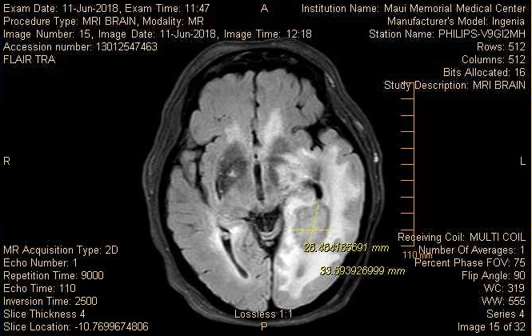
MRI Brain 6/11/2018
Impression: Large ring-enhancing mass with significant vasogenic edema in the left occipital parietal regions with slight mass effect and a few millimeter midline shift. This is suspicious for a necrotic malignancy. Differential lies between glioblastoma, lymphoma or metastatic disease. An infectious process such as an abscess would also be possible but less likely given the large mural nodule.

Slide 7
Hospital Stay Day #5
Presented to QMC to transfer, possible brain biopsy
QMC neurosurgeon reviewed MRI, stated likely high grade glioma, poor outcome regardless of treatment
Family asked to proceed with diagnostic biopsy
Patient developed increased lethargy despite IV decadron, intubated, started on 3% saline and transferred to QMC

Slide 8
Final diagnosis
Brain biopsy:
  EXTENSIVE NECROSIS WITH TOXOPLASMA ORGANISMS IDENTIFIED BY IMMUNOPEROXIDASE STAIN, CONSISTENT WITH NECROTITIZING TOXOPLASMA ENCEPHALITIS
Toxoplasma IgG > 1:400
Started on TMP/SMX
Remains hospitalized as of 7/19, poor nutrition, on PEG
Slowly improving

Slide 9
Summary
If something looks like an infection, it probably is!
Immune suppression - think lymphoma and atypical infections
Tissue diagnosis is critical!

Slide 10
Jumping Topics!

Slide 11
FFR-Guided PCI in Stable Angina

Slide 12
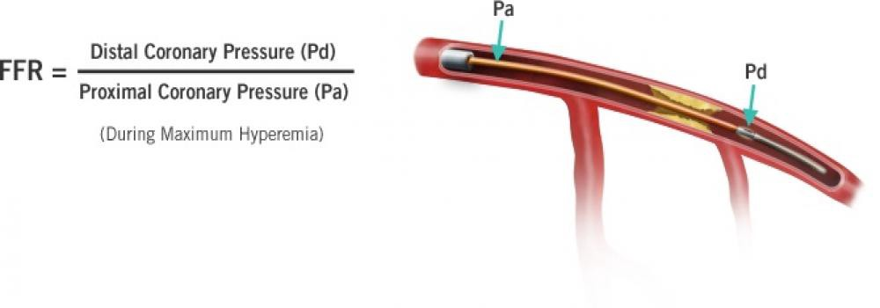
FAME-2 Trial
FAME-2 Trial
PCI vs Best Medical Management for stable CAD
Patients with FFR ≤0.8 randomized to BMM vs PCI+BMM
  FFR >0.8 received BMM and entered in registry
888 patients randomized, 332 in registery
Primary end point was a composite of death, myocardial infarction, or urgent revascularization
4.3% in PCI, 12.7% in BMM
  Urgent revascularization 1.6% vs 11.1%
Registry patients primary end point 3%
A technique used to measure pressure differences across a coronary artery stenosis to determine the likelihood that the stenosis impedes oxygen delivery to the heart muscle
FFR ≤0.8 considered “hemodynamically significant”
September 13, 2012 N Engl J Med 2012;

Slide 13
FAME-2 (5-Year Follow Up)
At 5 years, primary composite end point 13.9% in PCI vs 27% in BMM
  Urgent revascularization 6.3% vs 21%
Death 5.1% vs 5.2%
MI 8.1 vs 12% [CI 0.43-1]
Registry cohort primary end point 15.7%
CONCLUSIONS
In patients with stable coronary artery disease, an initial FFR-guided PCI strategy was associated with a significantly lower rate of the primary composite end point of death, myocardial infarction, or urgent revascularization at 5 years than medical therapy alone. Patients without hemodynamically significant stenoses had a favorable long-term outcome with medical therapy alone. (Funded by St. Jude Medical and others; FAME 2 ClinicalTrials.gov number, NCT01132495.)

Slide 14
Uptodate Summary
● Revascularization with either coronary artery bypass graft surgery (CABG) or percutaneous coronary intervention (PCI) is indicated in the following groups of patients with stable angina pectoris:
• Patients with activity-limiting symptoms despite optimal medical therapy
• Active patients who prefer PCI for improved quality of life compared to medical therapy
• Those with anatomy for which revascularization has a proven survival benefit (e.g. LM/LAD disease)
● Regardless of which method of revascularization is used, aggressive risk-factor modification is necessary in all patients.

