Slide 1



Everything you wanted to know
(but were afraid to ask)
urious
Menu
Antipasti
Bitter Pill of EMR
Primi Piatti
Our Present
Secondi Piatti
Yummy Usage Tidbits
Dolce
Sweet Taste Of Thing To Come
Lunch & Learn Series
March 15th, 2019
12pm Auditorium
Maui Memorial Medical Center
Constantin Novoselsky, MD
MHS KP HealthConnect Chef de Cuisine
Notes:
More Than One Way To Skin a Cow
Putting Money Where The Mouth Is

Slide 2
Disclaimers
I receive stipend from the hospital for EMR-related work
This talk is not funded by the hospital, KPHC or Epic
  I am free of commercial or institutional bias
Acknowledgement to Dr. Topher Sharp and Dr. Lindsay Stevens, of Stanford Healthcare
  For showing what is possible with Epic and serving as an inspiration for this talk

Slide 3
Objectives
Discuss impact of EHR on clinicians
Provide tools and knowledge to help clinician become clinicians again
Make everyone excited about the future
Save the world ☮

Slide 4
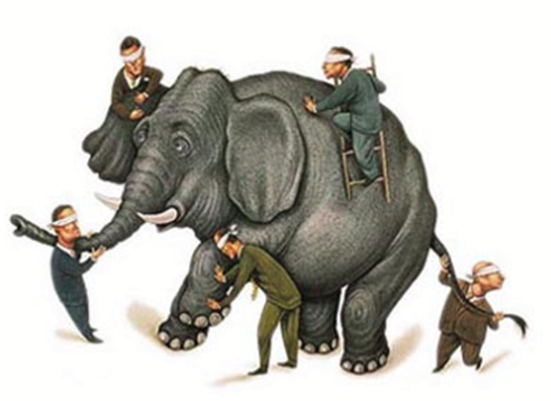
What is the EHR... and to whom?
Payers... the source of billing documentation.
Health care enterprises... a way to ensure compliance with organizational directives.
Legal system... a statement of legal facts.
Public health... a way to collect their data at drastically reduced costs.
Measurement entities... a way to automate the collection of measurement data.
Government entities... a way to observe and enforce compliance regulations.
Erickson SM, et al. Putting patients first by reducing administrative tasks in health care. Ann Intern Med. 2017;166:659-61.

Slide 5

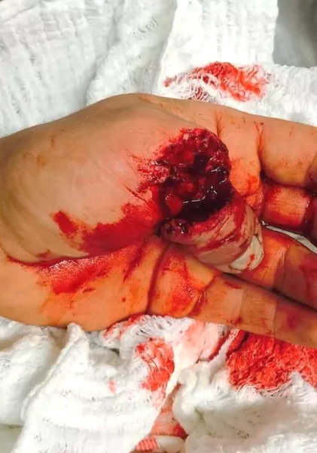

EHR is a Tool
Notes:
Not perfect, but Epic is really as good as it gets. Tools can be used to make beautiful items (Kizhi Pogost church built without a single nail), or one can meet Dr. Galpin

Slide 6
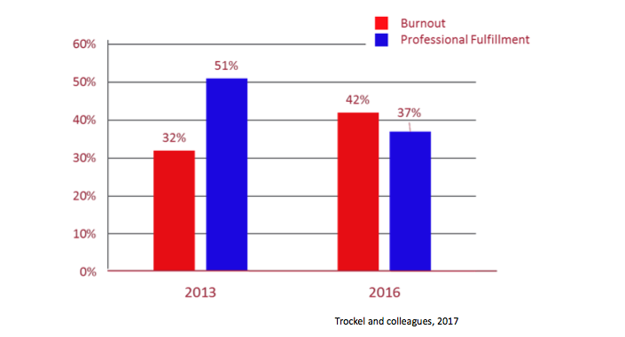

Stanford Physician Wellbeing Survey
Burnout is a syndrome of depersonalization, emotional exhaustion, and low personal accomplishment that leads to decreased effectiveness at work.
Burnout is the opposite of Wellness.

Slide 7
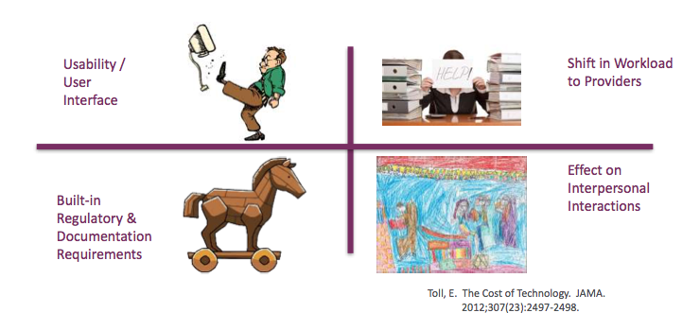

How the EHR Contributes to Burnout

Slide 8

Well Physicians = Higher Performance
Physicians Who are Well:
‒ Higher patient satisfaction (Beach, et al. 2013)
‒ More likely to support preventive health practices in patients (Duperly, et al., 2009; Frank, et al., 2008; Frank, et al. 2013)
‒ Lower medical error rate (Fahrenkoph, et al. 2008; Shanfelt, et al. 2010; West, et al. 2006)
‒ Better patient outcomes, e.g. decreased post-hospital discharge recovery times (Halbesleben and Rathert, 2008)
‒ Less likely to leave their organization

Slide 9

How the EHR Contributes to Burnout

Slide 10
What Else Can We Do About It?
Improve burden exacerbated by regulatory, institutional-related factors
ReducingProviderBurden@cms.hhs.gov
Admin support, regulatory changes, UI improvements
Adopt team-based approach and delegation of non-clinical tasks
Requires active feedback and participation of end-users (US!)

Slide 11

Annual Efficiency Check
Is all information on my patient list useful?
Is the first screen when chart opens important?
Does sequence of activities follow my workflow?
Can I easily find results of test that I frequently order?
Do I use patient & sidebar reports?
Am I able to order common ordersets using only 1-click?
Does Epic correctly suggest orders while I type?
Can I quickly find relevant notes?
Do I have templates that include drop-downs, lab/IO/vitals etc?
Do I use .phrases in addition to templates?
Do I use keyboard shortcuts?
If any is “NO” - this information is will help!
Notes:
More than one way to do things, some are more efficient that others. This summarizes

Slide 12
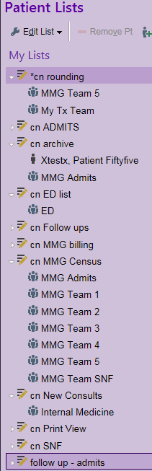
Setting up Patient Lists
Multiple folders can be created
Each folder can have a mix of system lists and manually added patients
Each folder view can be customized to clinician needs
  Right-click on folder name
  Choose “Properties”, then select columns
  Choose “Copy from” to “borrow” other provider’s setup (e.g. “cn rounding”)
Use “Hospital Chart” to find patients
  “Hospital Chart” might be in Epic menu

Slide 13
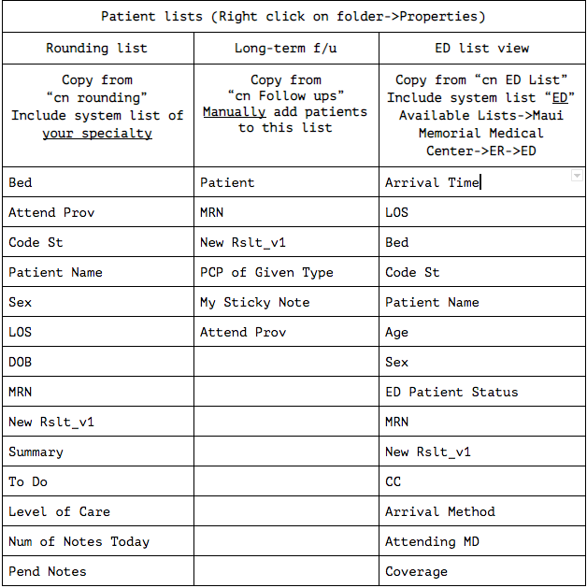

Slide 14
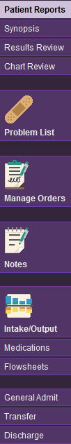
Chart Customization
Buttons (activities) on the left side of the screen
Patient Reports is default when opening chart *
Customize by clicking “Customize” on the bottom of the screen
Recommended layout for Medicine and sub-specialties
  Surgical and ED views may differ
* There are shortcuts to jump straight to orders and results from patient list

Slide 15

Patient & Sidebar Reports
Reports display information from several sources in one place
Usually, the default activity when opening chart
Patient reports are on the LEFT
Sidebar reports are on the RIGHT
Customize by clicking gearwrench

Slide 16
Common Patient and Sidebar Reports
Report (#1 is default) | Button Name | Descrition
Micro Rslt (Last 100 days) | Micro | Micro report last 100 days
Hospitalist Accordion | Rounds | Rounding at-a-glance
CCU Accordion | CCU | CCU roudning at-a-glance
Pt Care Timeline | ED | ED timeline from Triage
MD Cosign/Dear Dr | Dear Dr | Communication from staff
Lab Accordion | Labs | Comparative lab view
MAR (ALL by Frequency) | MAR | Medication admin records
Diet, IVF, Drains | LDA | Lines, drains etc
Wound Accordion | Wounds | Wound description
Rehab | PT/OT | Rehab notes
Transfusion Overview | BloodBank | Transfusions
Meds - PTA (PRINT ONLY) | PTA | Home medication list
Emergency Contacts | Ph# | Contact names and phones
ADT Facesheet | Facesheet | Printable facesheet
Glucose Mgmt Accordion | Glu | Glucose+insulin at-a-glance
MD Index | Index | List of common MD reports
Report (checkbox default) | Display Name | Descrition
HP IP COSIGN / DEAR DR D3 IP MD | Dear Dr | Staff communication (check as default)
HP IP COMPARATIVE LABS RESULTS | LabsNew | Brief comparison labs
HI IP VITALS SNAPSHOT D3 ALL | Vitals | Recent vitals
HI IP NUTRITION / DIETITIAN INFO D3 IP SPPTSVCS | Nutri | Diet, PO intake, weight
HI IP MEDS ADMIT (PTA) FOR DOCUMENTATION D3 MD | PTA | Home Medications
HI IP REHAB REPORT D3 | PT/OT | Rehab notes
HI IP ADT EVENTS D3 IP ALL | Team | Treatment team
HI D3 IP CR ENCOUNTER NOTES - IP PROGRESS | Notes | List of notes
HI IP PATIENT TIMELINE | Timeline | Patient event timeline
HI IP INDEX LINKS D3 IP MD | Index | List of common MD reports
KPHI ADT CUSTOM FACESHEET | Facesheet | Printable facesheet

Slide 17
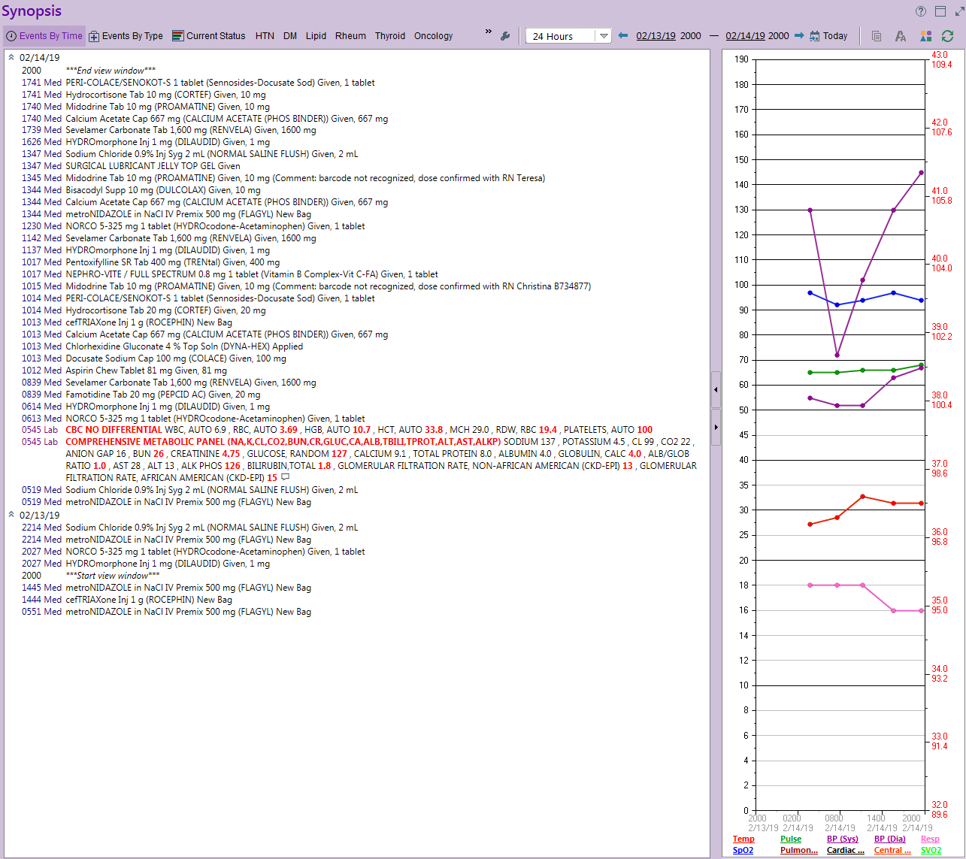
Synopsis
At-a-glance overview of medications, labs, and vitals
Choose “Events By Time” to see most recent doses
Choose “Events By Type” to group by medication/result
Hover over item to see the corresponding set of vitals
Change timeframe as needed

Slide 18
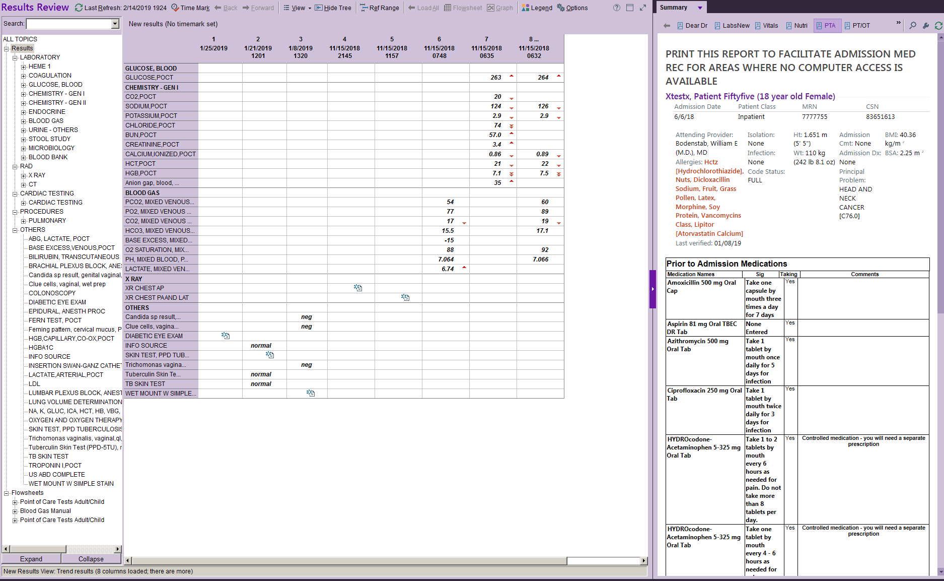
Simultaneous View of Current Labs and PTA Medications

Slide 19
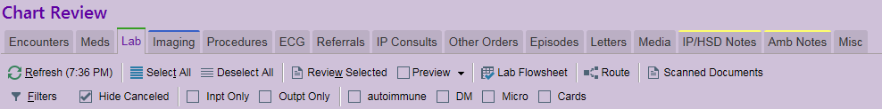
Result Review & Chart Review
Either can be used to display results
Result review is convenient for comparisons and trends
  Click on test name, then “Flowsheet” to show all values
Chart review is more comprehensive, includes all prior encounters, labs, x-rays, orders etc
  Filters in Chart Review allow to quickly find groups of studies
  Shown below “autoimmune, DM, Micro, Cards”

Slide 20
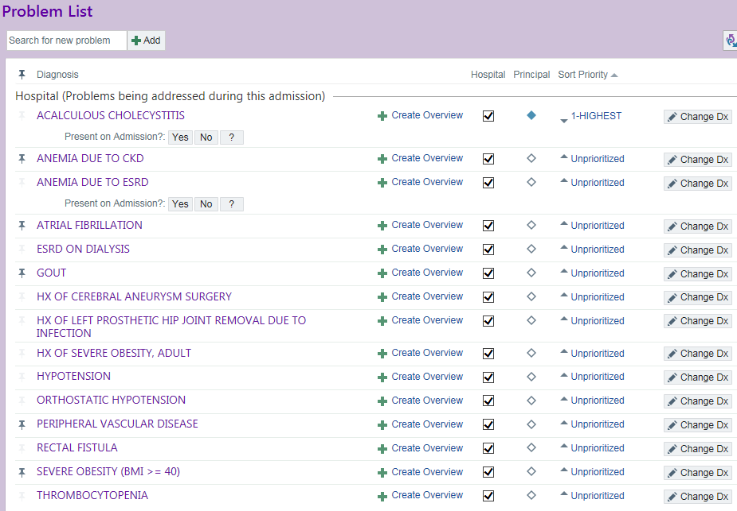
Problem List
Epic has versatile problem list management
Customization:
  Whether problem is addressed in this
  hospital stay or not
  Set principal problem
  Set priority (1-5, unprioritized)
  Add overview - information that is
  relevant for all people reviewing chart,
  such as HbA1c or last EF%
Search for problems can use partial
words, or “-” if term to be excluded
Problem list can be included in notes
with or without the overview text

Slide 21
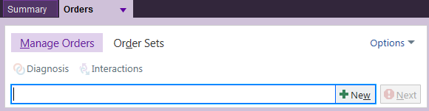
Orders!
Search works both for orders and
ordersets
  No need to switch between
  “Manage Orders” and “Order Sets”
Frequently used orders will be shows as you type
  Use keyboard to scroll down and press “enter”
  Prefix “favorite orders” with your initials for easier search

Slide 22
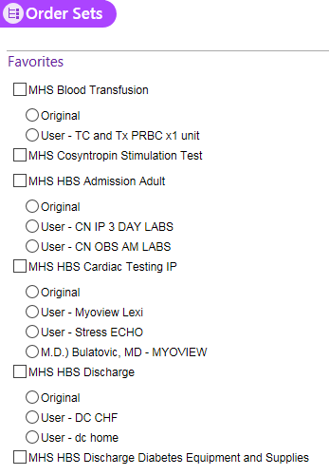
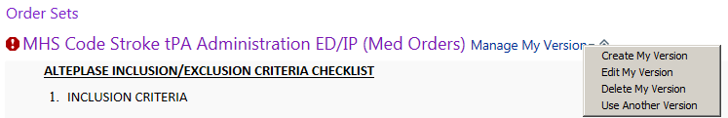
Ordersets - “My Versions”
Extreme time-saver!
One-click ordering of common orders
Multiple versions of orderset can be created
Find orderset
Click “Manage My Version”
Select “Create My Version”

Slide 23
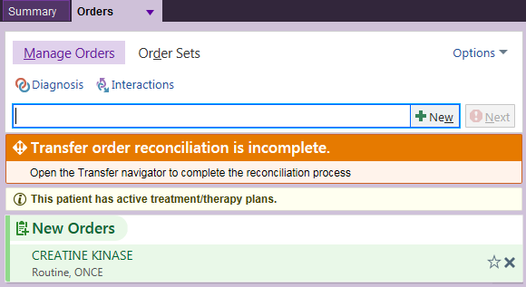
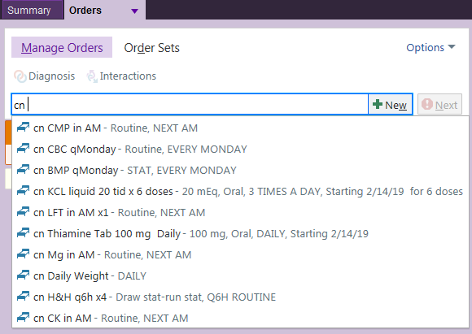
Favorite Orders
(AKA Personal Preference List)
Orders the way you like them!

Slide 24
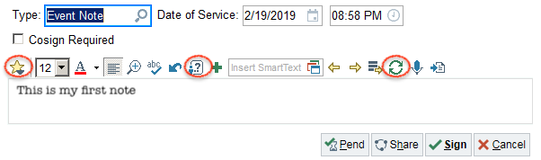
Notes
Have at least 3-4 templates
  H&P, DC Summary, Progress Note, Procedure Note
Share best templates
Learn few additional smartphrases
Use basic formatting for better legibility
Use M-Modal
Pend - to be completed later by me (only visible to me)
- adds to patient list
Share - to be completed later by anyone (visible to anyone)

Slide 25
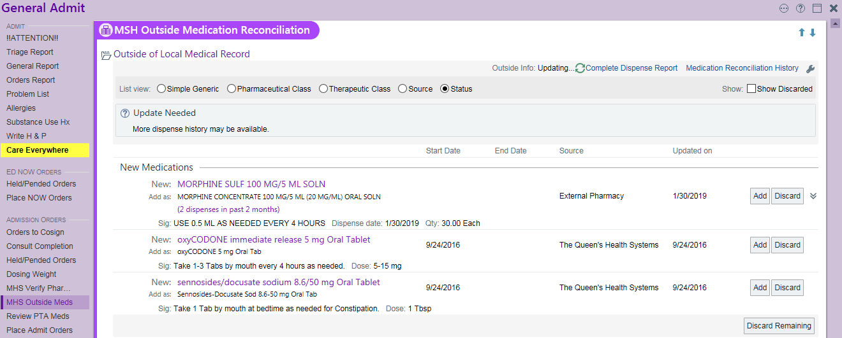
Quick Bites - SureScripts Prescription Data
NEW section in Admission & Discharge Navigators
MHS Verify Rx
MHS Outside Meds

Slide 26
Quick Bites - Keyboard Shortcuts
Alt+S =
Alt+C =
Alt+A =
Alt+N = Next
Alt+B = “Benefits outweigh risks”
CTRL+O will open “Manage orders”, no matter where in the chart
CTRL+Space opens “Full Chart Search”
Anywhere there is is time/date
“t” - today’s day, “t+1” tomorrow, “t-7” 7 days prior etc...
“n” - now time, “n+1” one hour from now, etc...

Slide 27
Quick Bites - Text Editing
Ctrl+C = Copy
Ctrl+V = Paste
Ctrl+B = Bold text (Ctrl+I = Italic, Ctrl+U = Underscore)
Ctrl+Z = Undo
Ctrl+A= Select ALL
F2 = Next ***
Shift+F2 = Previous ***
F3 = Open large text window
Alt+S =
Alt+P = Pend note

Slide 28
Quick Bites - Patient List
Double-click on “New Rslt_v1” column to go to results
Double-click on “Pend Notes” column to go to notes
Double-click on “Sticky note” column to open sticky note
Quickly find patient using (top right corner)
Click on column header and start typing to jump to patient
“Patient list reports”
  Click triangle on the bottom of patient list to expand reports
  Right-click on folder, go to properties->advanced
  Choose “Default Report”
    Usually, choose “MD Cosign/Dear Dr”, “Comparative Labs” or “Rad Results”
    Additional reports can be set up using

Slide 29
Quick Bites - Results Review
Click “Time mark” to be notified on “Patient List” when new results are available
Click “View” to show “timemarked” results again
Use keyboard “up” and “down” arrows to quickly move between Result Review groups
Shift-click or Ctrl+click to select multiple tests to view Trend of Flowsheet

Slide 30
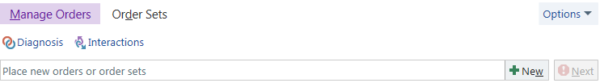
Quick Bites - Orders
Edit multiple orders at once under “Options”
Check interactions (drug-drug, drug-lab, drug-diagnosis)
Favorite orders can also be created for Discharge Meds, including sigs!

Slide 31
Quick Bites - Notes
Set up default “Filter” to show only provider notes
  Click “Filter”, “Clear All”
  Select all “Dentist”, “Nurse Practitioner”, “Physician”, “Podiatrist” and “Physician Assistant” roles
  Click “Save Pref”
  Remember to UN-filter (Select All) to view all notes again
Quickly find your notes by clicking “Show My Notes”
“Pended” notes can be quickly accessed from “Patient List” or In-basket

Slide 32

Quick Bites - Smart Stuff
.HPROBL - problem list, including overview/comments
.hprobnodtnocmt (no overview, no dates)
.probhosp - each problem has *** for assessment and plan
.ptmeddischref - discharge meds from med rec, refreshable
.afutappt - follow up appointments
.td - today's date
.tdr - today's date refreshable (useful when using COPY)
.now - now time
.nowr - now time refreshable (useful when using COPY)
.id - patient's name and age
.me - “my” name
.rcntbrief (72 hours of common labs)
.rcntcardiac (recent cardiac labs)
.labrcnt[wbc:3,cr:3 - last 3 WBC, Hb, Cr values - uses "base name"
.lastlab[wbc:3,cr:3 - similar, 2 separate tables
Find base name - Chart Review -> click on lab -> scroll to bottom ->”View Smartlink Info”
.LASTxxx
//where xx can be trop, bnp, lft, hga1c, na, tsh, ldl, mribr etc
.rcntresultnr[24h - all recent labs AND xrays - very ugly!!!
.lastculture5
.procrslt[87070F for respiratory culture
.MHSCHFCORE
.MHSCODEBLUE
.MHSMTP
.LDA[2 // display detailed info about drains
.RRDIET
.RRIOYESTERDAY
.RRDAYSPOSTSURGERY
.RRVITALSSUM // vitals summary
.tmax[12 // min, max, average temp 12 hours
.vshosp[12 // tabular view of vitals last 12 hours
.vs OR .vsp OR .vitals //more views of vitals
.IPFLOW[96:14 //weight last 96 hours
.IPFLOW[24:1330 //diet last 24 hours
.IPFLOW[12:71418 //last 12 hours of vent settings
.FLOW[60209 //Central Lines
.FLOW[7637 //All IV
.FLOW[86113 //Foley
.FLOW[67892 //Isolation
Search and find more relevant smart phrases and smart links

Slide 33
Quick Bites - In-basket
Filter by deficiency type under “Sort & Filter”
Select multiple orders to sign by Shift+click
Quickly jump to chart by clicking “Hospital Chart” or “Encounter”

Slide 34

Upgrade! Upgrade!
Epic v. 2018 & 2019 upgrade - August 2019
New DC med rec
Improved orders search
Saving favorite panels
LDA Avatar
Bookmarks in chart review
Sepsis narrator
Nurse brain
Summary view
Blood bank changes
New culture susceptibility layout
Improved notes navigation
Medications hold
Immunization registry

Slide 35
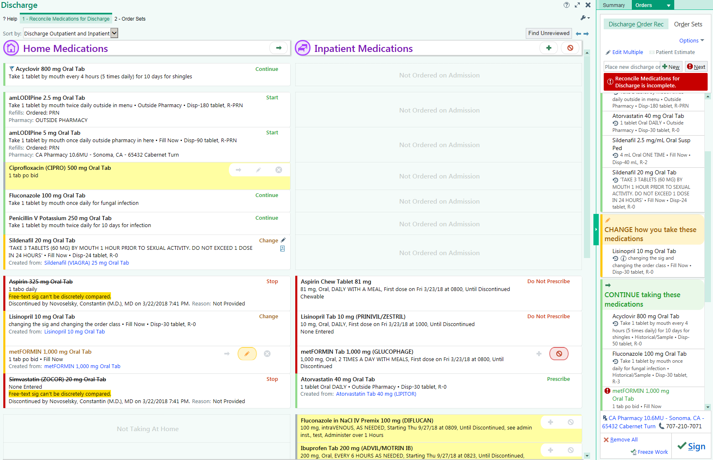

Slide 36
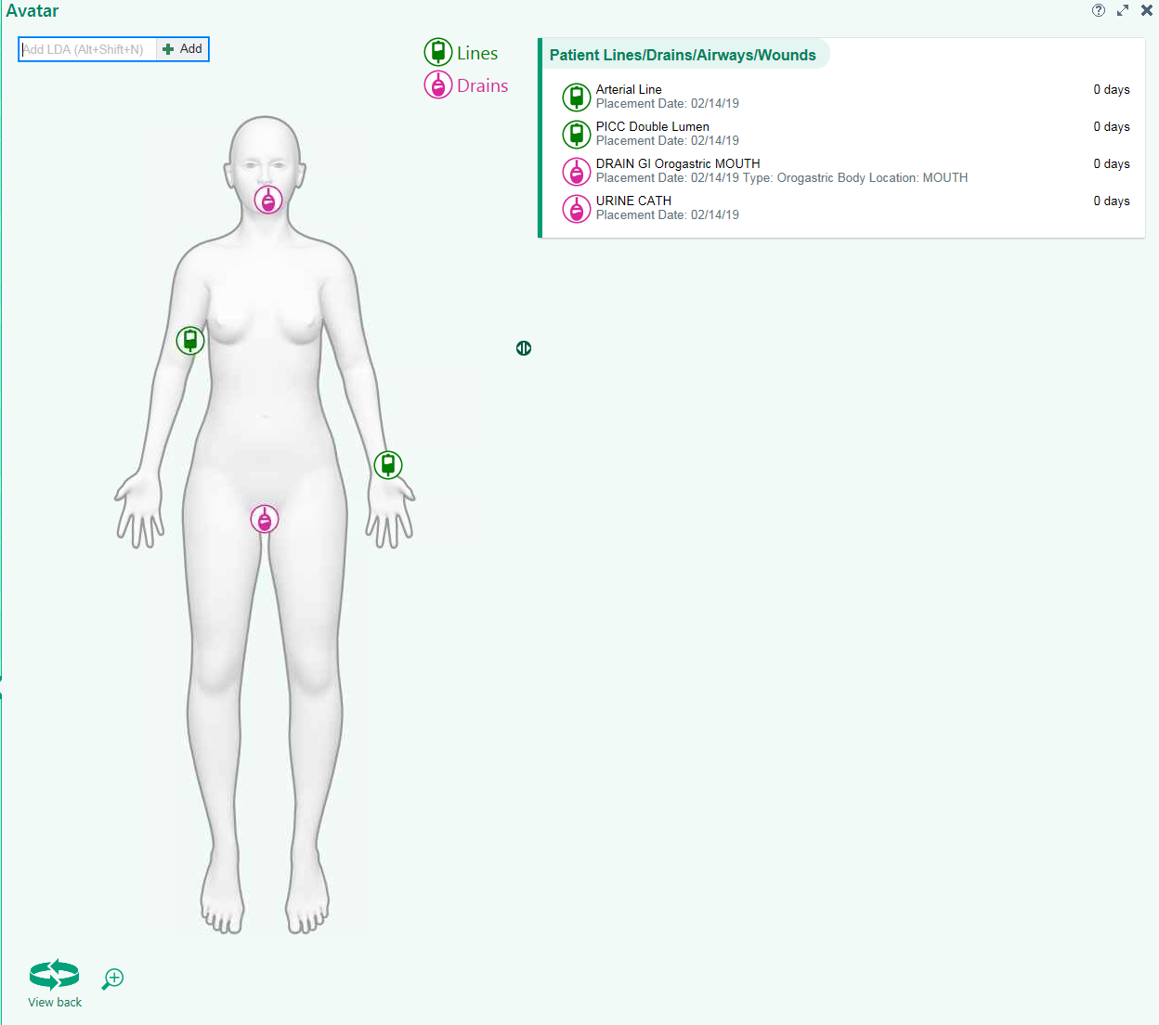

Slide 37
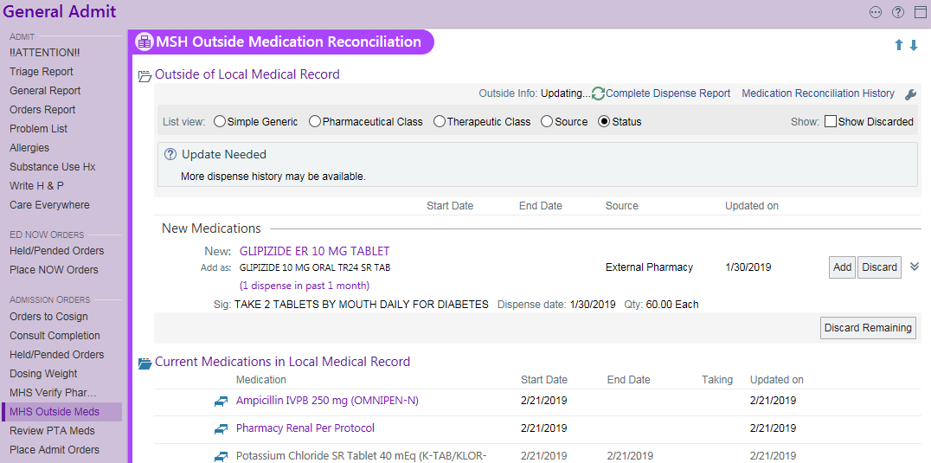
Just in! - SureScripts Med Dispense History
2
3
1
Notes:
More than one way to do things, some are more efficient that others. This summarizes

Slide 38
Fin
808md.info/cme
Questions/Comments?
cnovoselsky@gmail.com
C. 718-759-7001
Constantin Novoselsky, MD - MHS Physician Lead
Tammy Apana RN, Julie Bello RN - MHS Nurse Informatics

