Slide 1
MHS Epic 2019 Upgrade
Playbook (Maui)

Slide 2
Downtime Aug 10th 0000-0600
Downtime
See Clinical Informaticists sharepoint for Downtime Info folder
Downtime Instructions Folder
Refer to checklist for scheduled downtime guidelines
Downtime Data Recovery
Refer to checklist for backloading guidelines
Reference: EMR Downtime Policies and Procedures

Slide 3
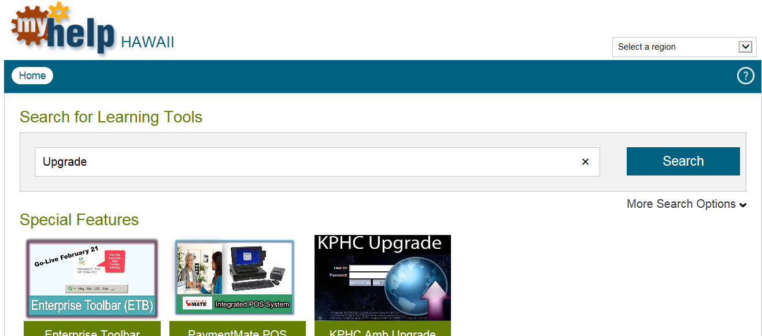
Upgrade Resources
MyHelp Hawaii
https://myhelp.kp.org/?regionid=5&a=0.9640422855594875
Search Upgrade and look for “2019” in the title

Slide 4
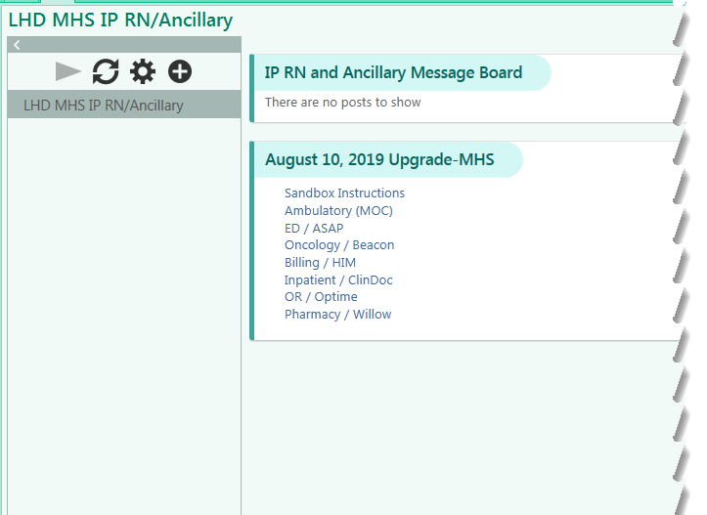
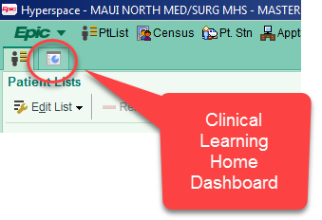
Upgrade Resources - continued
Clinical Learning Home Dashboard in Epic

Slide 6
Sandbox Access – continued on next slide
At the log in screen use one of the user IDs below with the password train123
Role | User ID (use any number between 1-10) | Role | User ID (use any number between 1-10)
ED Clerk | medclerk1 | Ward Clerk | mhswc1
ED Scribe | medscribe1 | ED MD | mhsed
ED Tech | medtech1 | Hospitalist | mz998101
Hospital Aide | mhsha1 | Surgeon | msurge1
RN – Inpatient | mhsiprn1 | Oncologist | M540401
RN – Emergency | mhsedrn1 | OB MD | mhsobmd1
RN – L&D | mldorrn1 | Pharmacy Tech | m440301
RN – OR | morrn1 | Role | User ID (use any number between 1-5)
RN – HBV | mhbvrn1 | OT | mhsot1
Ward Clerk | mhswc1 | ST | mhsst1
RN – ACS | macs1 | PT | Mhspt1
RN – Oncology | m540501 | RT | mhsrt1

Slide 7
Sandbox Access - continued
At the log in screen use one of the user IDs below with the password train123
Appointments/Registration, Admitting, Business Services
Role | User ID (use any number between 1-10)
Admitting | mhsadm1
DI Front Desk Reg. | mhsdireg1
Financial Counselor | mhsfc1
Lead Clerk | mhslead1
Appt. Reg. Clerk | mhsreg1

Slide 8
SME Schedule for Upgrade Go-Live (Sat & Sun)
SME | Contact Number | Day Shift Saturday Aug 10th | Night Shift Saturday Aug 10th-11th | Day Shift Sunday Aug 11th | Night Shift Sunday Aug 11th-12th
Novy Haban | x4700 | 0600-1200
Kasumi Johnson | x4702 | 0600-1830
Pauline Pease | x4703 | 0700-1930
Rozz DeCastro | x4704 | 0600-1000
Amy Wallace | x4705 | 0600-1000
Karen Buduan | x4706 | 0700-1930 |  | 0700-1930
Divina Yoro | x4709 | 1100- | 2300
Chrissy Huntley | x4710 |  |  | 0700-1930
May Lacio | x4712 |  |  | 1000- | 2030
Laura Masslon | x4700 |  |  |  | 1900-0730
Shawna Dunlap | x4702 |  | 1900-0730
Khendy Bacay | x4703 |  | 1900-0730 |  | 1900-0730
Richard Barcus | x4704 |  | 1900-0730
Alexa Ballesteros | x4705 |  | 1900-0730 |  | 1900-0730

Slide 9
SME Schedule for Upgrade Go-Live (Mon & Tues)
SME | Contact Number | Day Shift Monday Aug 12th | Night Shift Monday Aug 12th-13th | Day Shift Tuesday Aug 13th | Night Shift Tuesday Aug 13th-14th
Nikki Baysa | x4700 | 1000-1400
Amy Wallace | x4705 | 0700-1930
Chrissy Huntley | x4710 | 0700-1930
May Lacio | x4712 | 1000- | 2030
Amanda Chrisman | x4703 |  |  | 0730-1200
Guy Haywood | x4704 |  |  | 0700-1930
Michael Kokubun | x4700 |  | 0700-1930 |  | 0700-1930
Shawna Dunlap | x4702 |  | 0700-1930
Lana Hai | x4711 |  | 1630- | 0500

Slide 10
MHS Command Center (Maui)
Physician Support
0600-1800 Saturday & Sunday, 0600-1830 Mon-Wed
Call KPHC Help Desk 808-432-3012
1801-0559 Saturday & Sunday, 1831-0559 Mon-Wed
1st Call SME (see schedule)
2nd Contact Service Desk x4100 or (808)432-4100
Command Center Support:
Hours of Operation
0500-2000 on Saturday, Aug 10
0600-2000 on Sunday, Aug 11
0700-2000 on Monday, Aug 12
0700-2000 on Tuesday, Aug 13
Support Process during Command Center Hours:
1st Contact a SME from Schedule for Upgrade Go-Live
Call any SME from list
2nd MHS Command Center - x7151
You will be joining a conference call in progress
Identify yourself, department, and provide a brief description of the issue; a command center facilitator will log your issue.
Support Process after hours:
1st Contact a SME from Schedule for Upgrade Go-Live
2nd Contact Service Desk x4100

